Slide 1
GenAI HW3 以API快速搭建自己的應用
TA: 尤展鴻，陳守仁，呂睿超
ntu-gen-ai-2024-spring-ta@googlegroups.com
Deadline: 2024/03/21 23:59:59 (UTC+8)

Slide 2
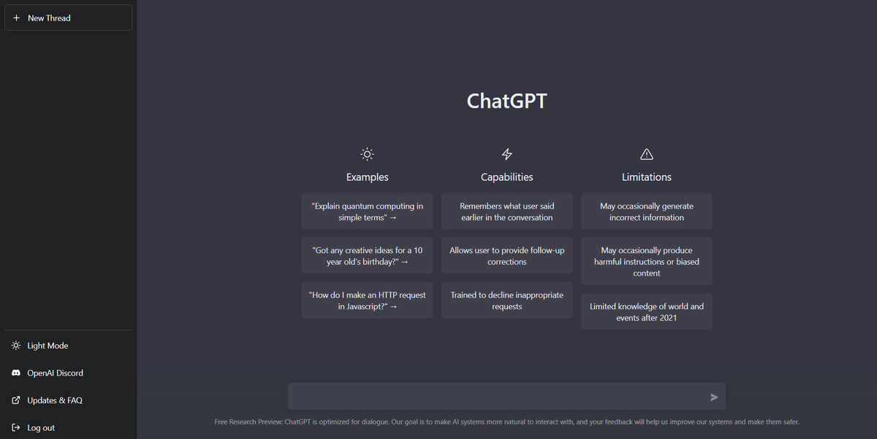
Using ChatGPT Model by Browser
In the HW2, we use ChatGPT model through the browser interface
User query
ChatGPT model
Response
Browser

Slide 3
Creating Your Own Application Using ChatGPT
For example, you want to create an App (應用程式) that adds appropriate emojis to any given input, and you want to power it by ChatGPT
Emoji Adder App
User input:
Human evaluation is indispensable and inevitable for assessing the quality of texts generated by machine learning models or written by humans.
Paragraph with emoji:
ChatGPT model
Human evaluation 🧑‍🔬 is indispensable and inevitable 🚫 for assessing the quality of texts 📝 generated by machine learning models 🤖 or written by humans 📖.

Slide 4
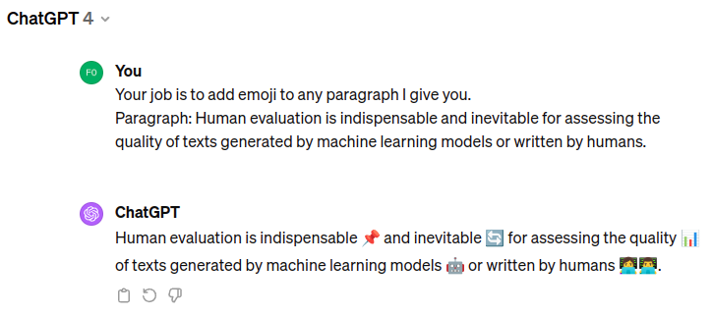
Creating Your Own Application Using ChatGPT
While you can manually copy the user input to the browser and copy the response from ChatGPT to the user end, this is too slow
Emoji Adder App
User input:
Human evaluation is indispensable and inevitable for assessing the quality of texts generated by machine learning models or written by humans.
Paragraph with emoji:
Human evaluation 🧑‍🔬 is indispensable and inevitable 🚫 for assessing the quality of texts 📝 generated by machine learning models 🤖 or written by humans 📖.
Browser

Slide 5
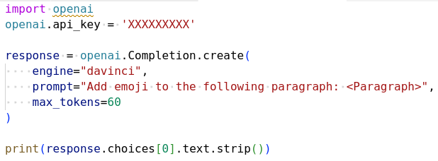
Creating Your Own Application Using ChatGPT API
The ChatGPT API (Application Programming Interface) enable programmatic (程式化的) interaction with the ChatGPT model
Emoji Adder App
User input:
Human evaluation is indispensable and inevitable for assessing the quality of texts generated by machine learning models or written by humans.
Paragraph with emoji:
ChatGPT model
Human evaluation 🧑‍🔬 is indispensable and inevitable 🚫 for assessing the quality of texts 📝 generated by machine learning models 🤖 or written by humans 📖.
Response: ………..

Slide 6
Creating Your Own Application Using ChatGPT API
You tell ChatGPT what you want it to do in a programmatic way
Emoji Adder App
User input:
Human evaluation is indispensable and inevitable for assessing the quality of texts generated by machine learning models or written by humans.
Paragraph with emoji:
ChatGPT model
Human evaluation 🧑‍🔬 is indispensable and inevitable 🚫 for assessing the quality of texts 📝 generated by machine learning models 🤖 or written by humans 📖.
Response: ………..

Slide 7
Creating Your Own Application Using ChatGPT API
ChatGPT return the response by following you what you ask it to do
Emoji Adder App
User input:
Human evaluation is indispensable and inevitable for assessing the quality of texts generated by machine learning models or written by humans.
Paragraph with emoji:
ChatGPT model
Human evaluation 🧑‍🔬 is indispensable and inevitable 🚫 for assessing the quality of texts 📝 generated by machine learning models 🤖 or written by humans 📖.
Response: ………..

Slide 8
What You Will Learn in This Homework
You will learn how to build some simple applications using ChatGPT with its API
You will learn how to call the ChatGPT API (and other APIs)
You will learn how to design the prompts to achieve the functionality you want
2.

Slide 9


What You Will Learn in This Homework
You will learn how to build some simple applications using ChatGPT with its API
Need to write some codes Google Colab
Need some place to host the APP Gradio

Slide 10
Overview in Today’s TA Lecture
Step 1: Learn how to use colab for coding and Gradio for demo
Step 2: Learn what API you can use and how to obtain the API keys (similar to password)
Step 3: Create an application on Colab and Gradio using the API

Slide 11
Warning of Codings

Slide 12
No worries, the TAs have already written the codes.

Slide 13
Outline
Colab and Gradio Tutorial: For coding and demo
Available APIs: APIs you can use to build your own APP
Formal Task Introduction: The APPs you need to create in HW3
Grading by Evaluation Assistants on DaVinci
Submission and Grading on NTU COOL
Important Dates
Regulations

Slide 14
Links
NTU Cool HW3 Forum
MediaTek DaVinci
OpenAI ChatGPT
Google Gemini
Colab link to this homework

Slide 15
Colab and Gradio Tutorial

Slide 16
Introduction
What is Colab?
Colab, or "Colaboratory", allows you to write and execute Python in your
browser, with
Zero configuration required
Free access to GPUs
Easy sharing

Slide 17
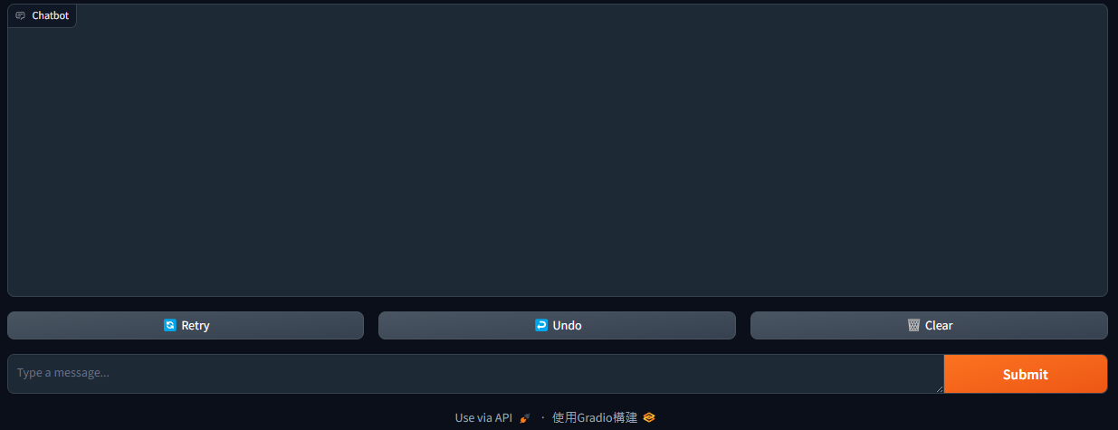
Introduction
What is Gradio?
Gradio is a tool that allows you to demo any application with a friendly website so that anyone can use it, anywhere.
We will use the following google colab notebook for tutorial demonstration
https://colab.research.google.com/drive/1N7WTdVseHg4pNQpDMENo2aHOfsCS2-If?usp=sharing

Slide 18
Demo for Colab and Gradio Tutorial

Slide 19
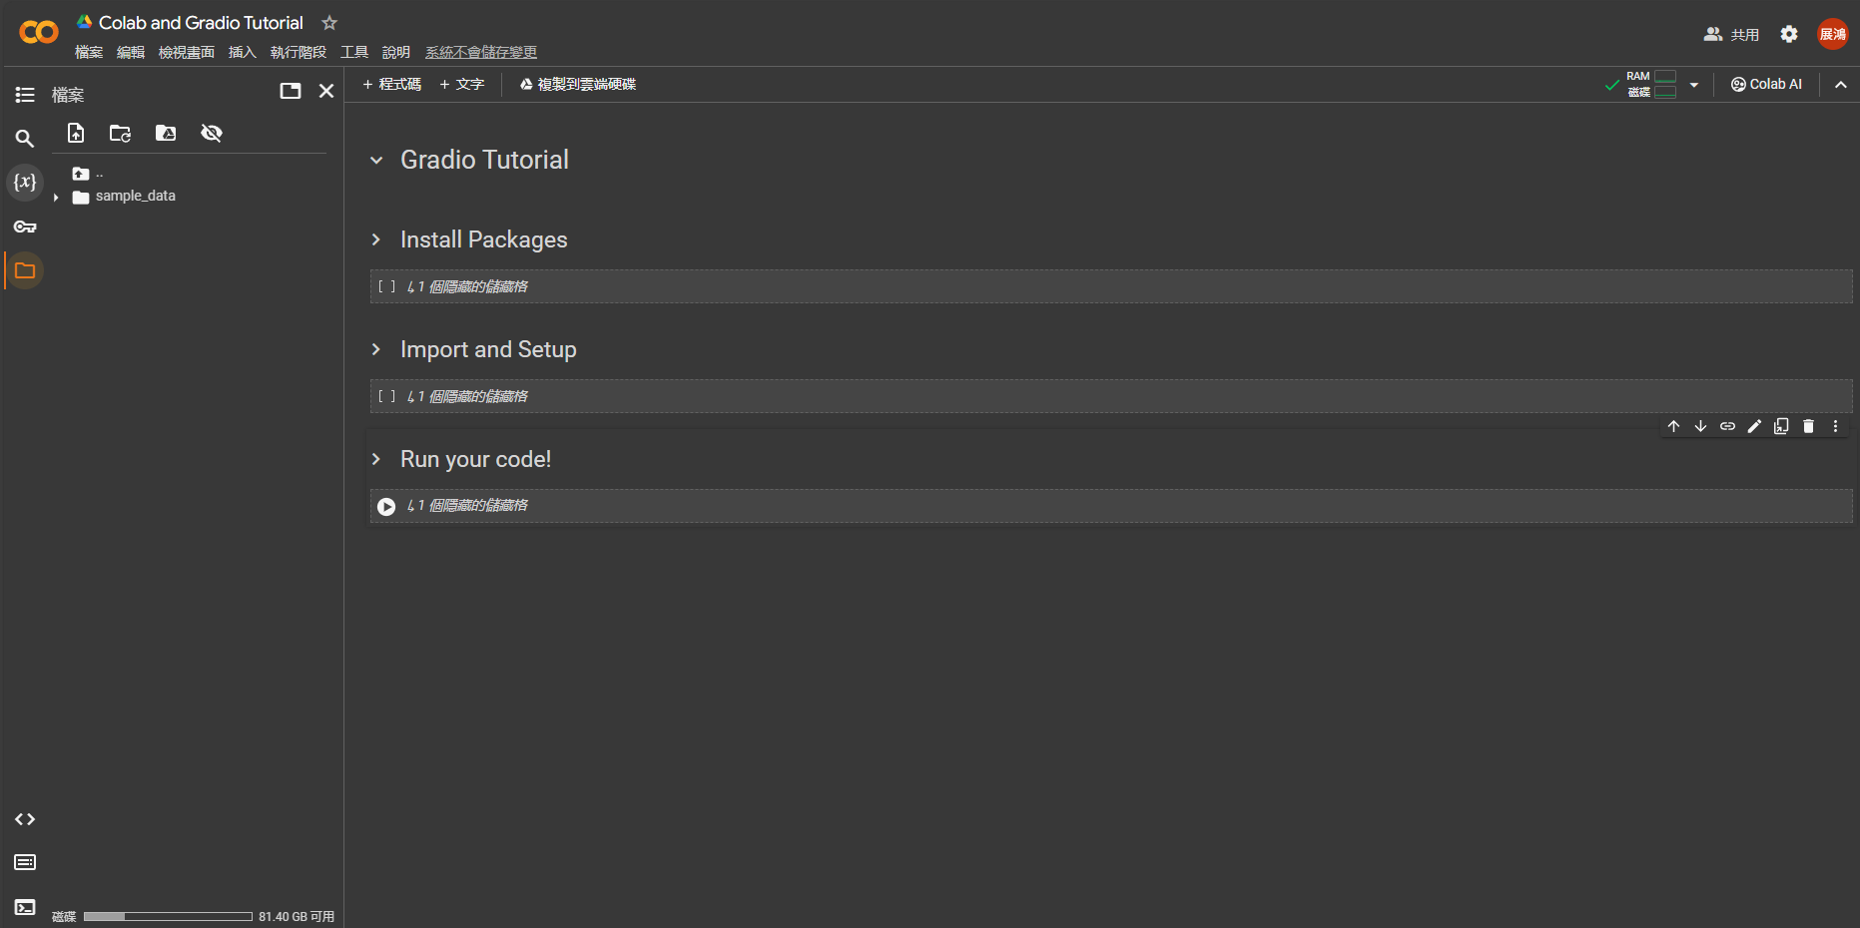
Create a copy in your drive

Slide 20
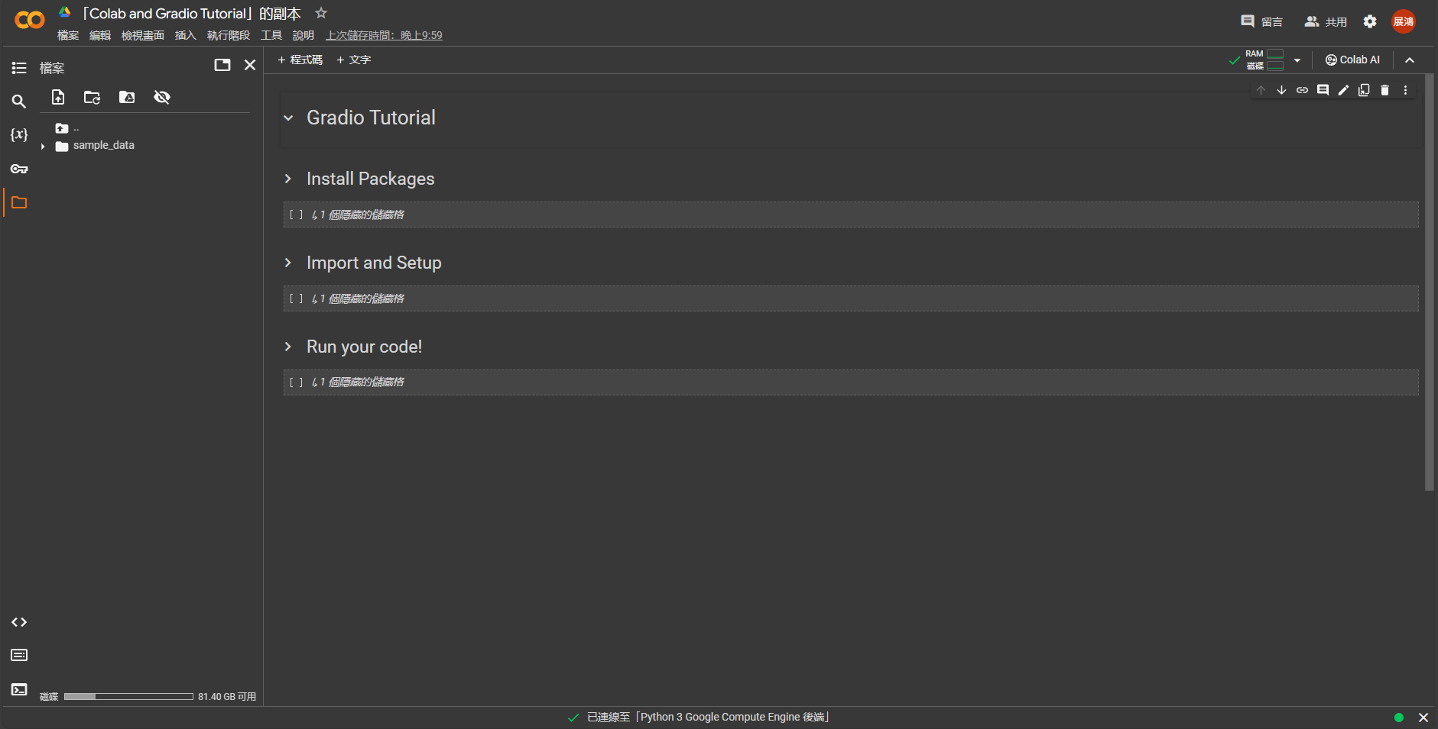
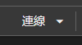
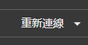
You can change the name here
If it looks like these:
Hit it again.
Click this to unfold the blocks
File location

Slide 21
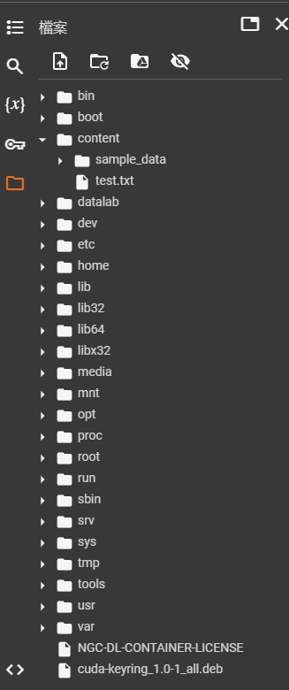
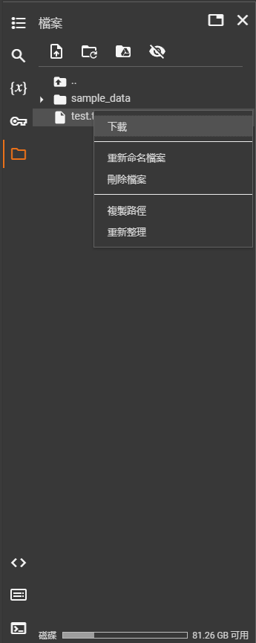
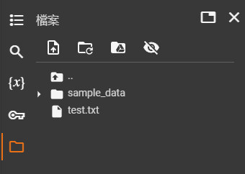
Upload your file
You can find your files here
Download your file
If you accidently click this

Slide 22
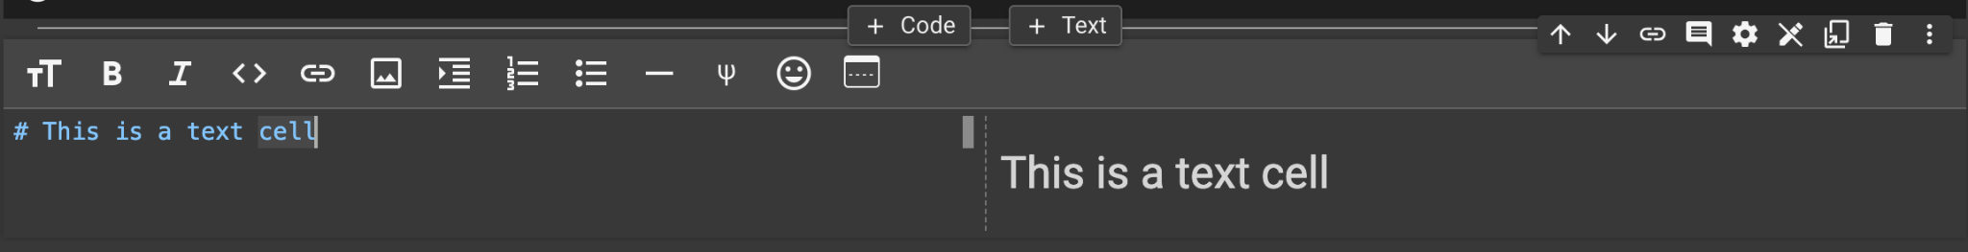
Cells
Create a new cell by clicking on + Code or + Text
These options allow you to moving your cell up/down or copy and deleting it

Slide 23
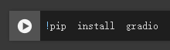
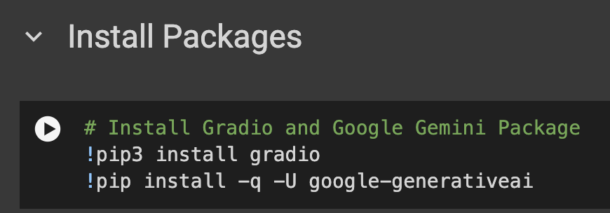
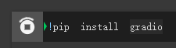
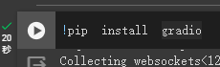
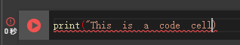
Run Cell
Code Unexecuted
Run Cell by clicking on the
Code Executing
Code Executed
Error Occurred

Slide 24
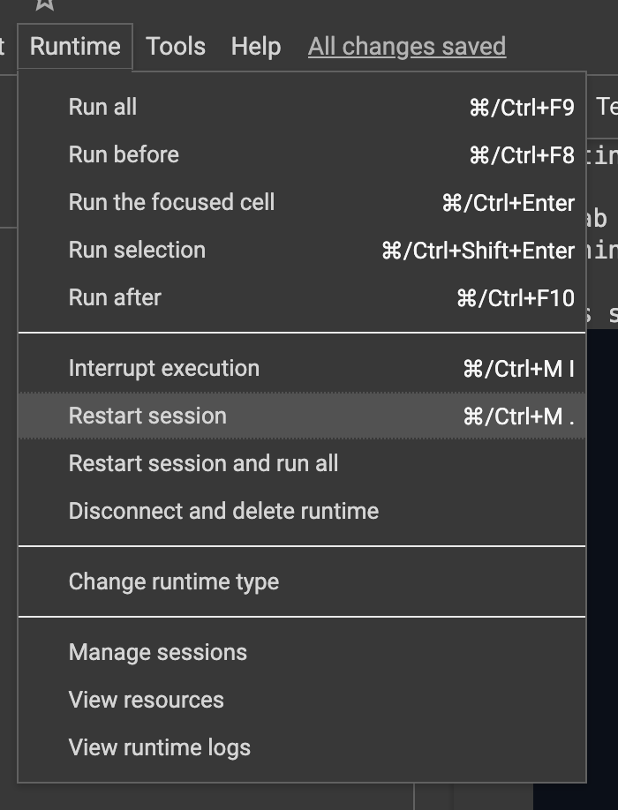
Problems you may encounter
Colab will automatically disconnect if idle timeout (90 min., sometimes varying) or when your screen goes black.
If you “Disconnect and delete runtime” or “Restart Session”, your files will be gone.

Slide 25
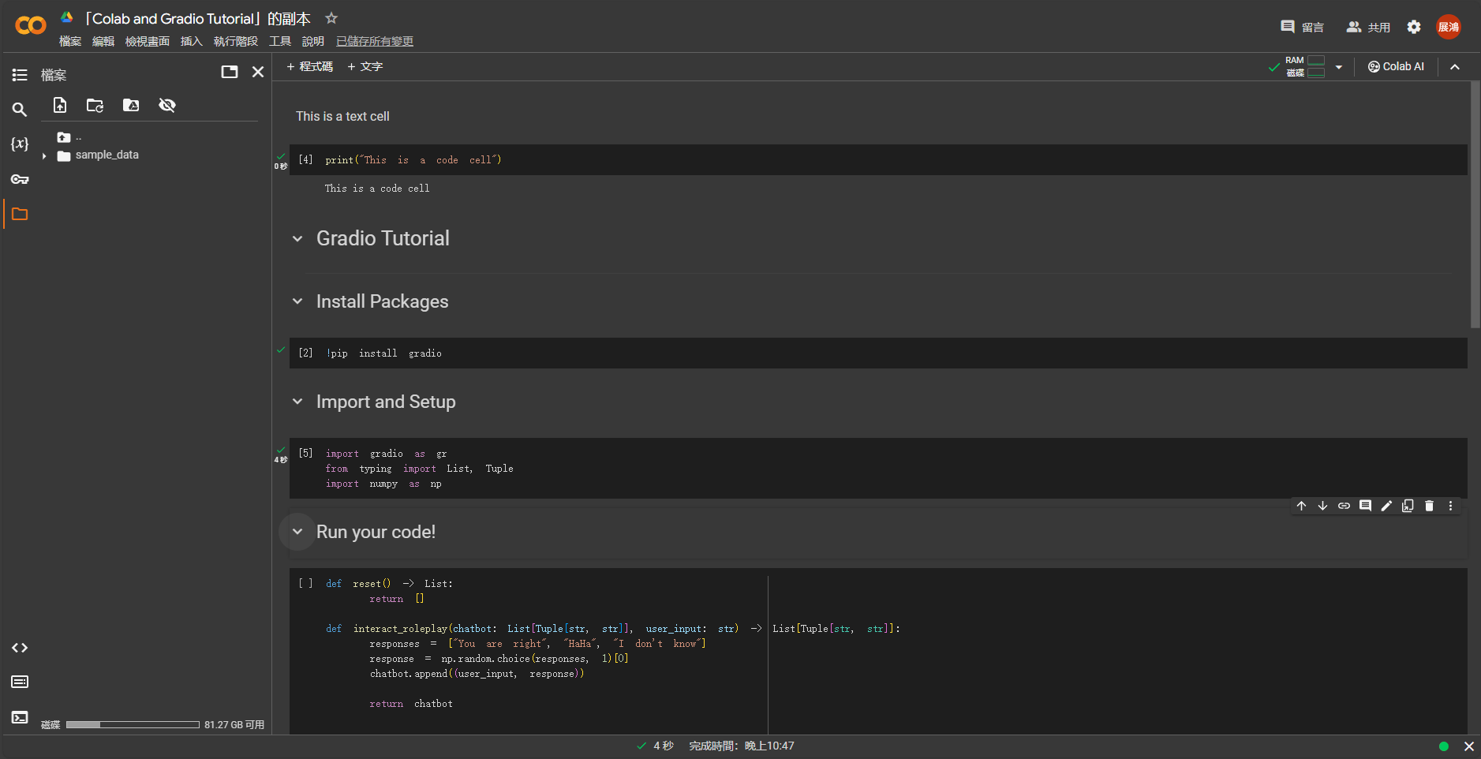
Run these three blocks from top to down

Slide 26
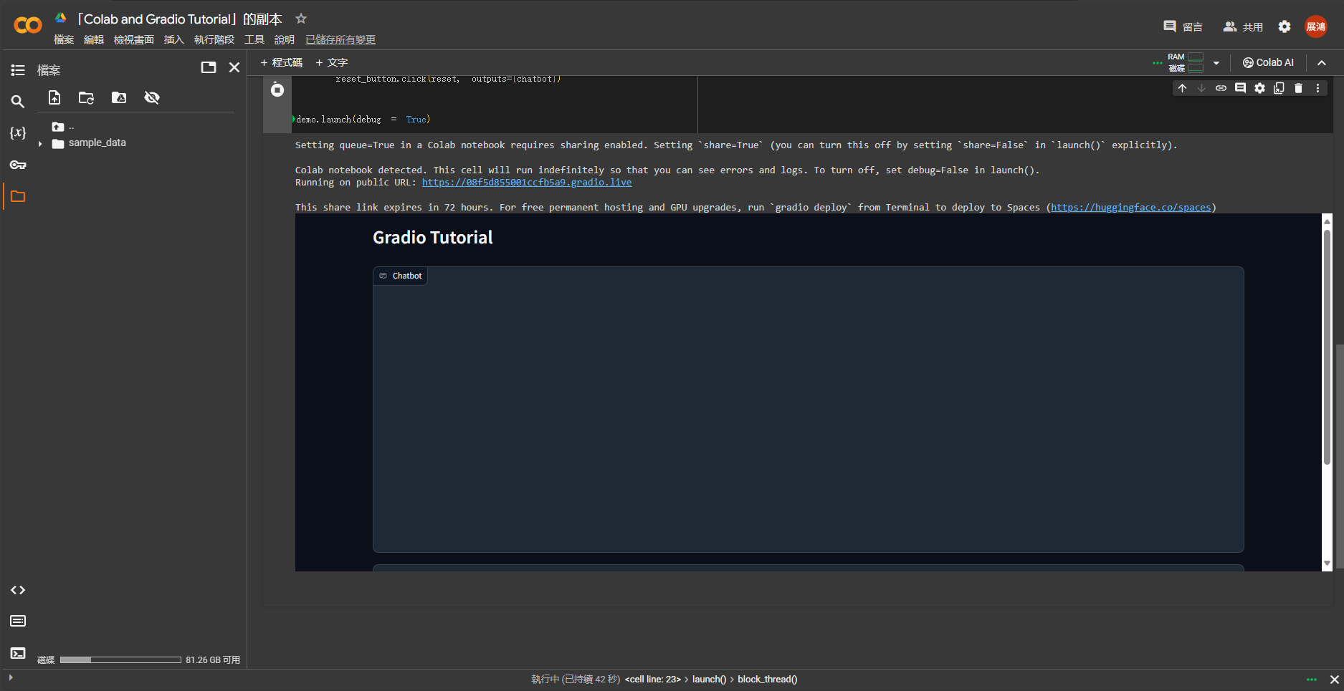
Click this link will lead you to a browser version gradio
You can also use gradio inside colab

Slide 27
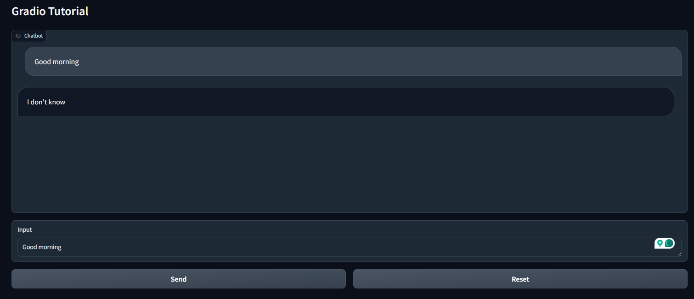
Dialogue
Input box
Click Send to enter your input
Click Reset to reset the dialogue

Slide 28
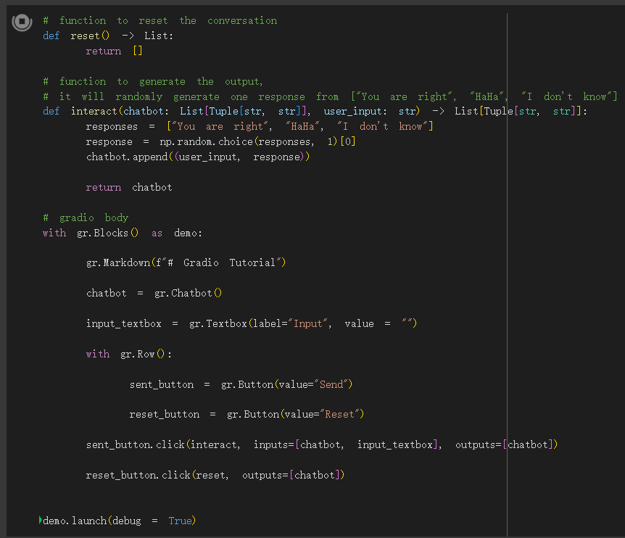
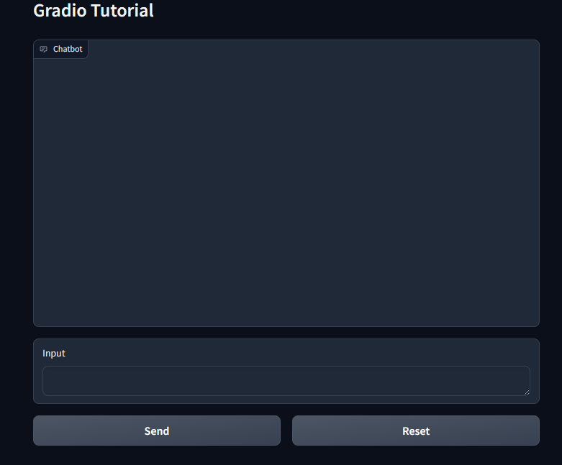

Slide 29
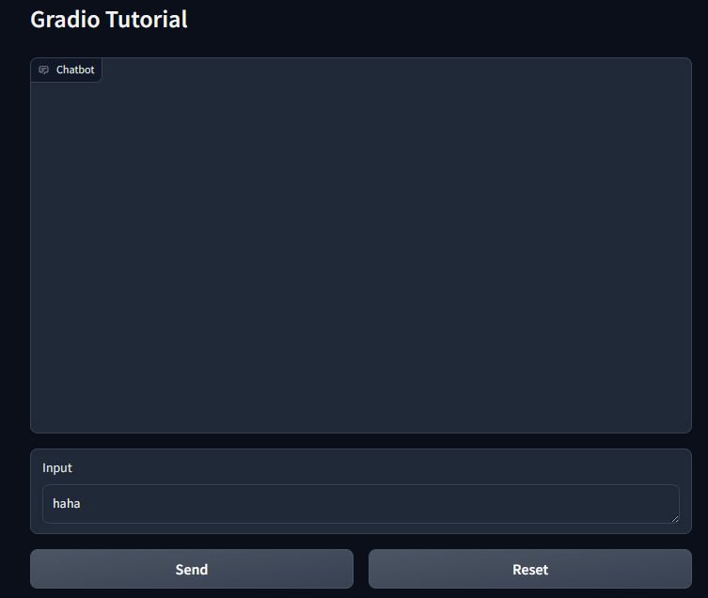

Slide 30
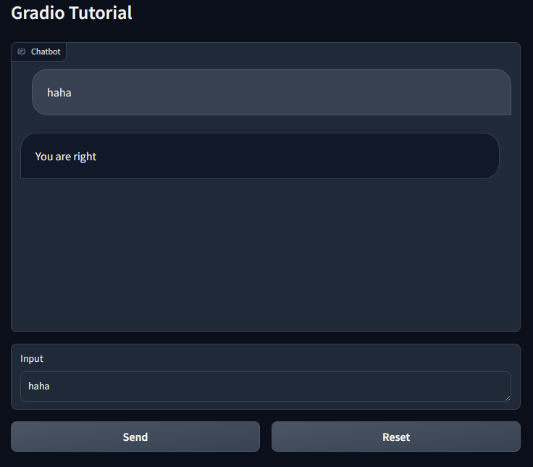
When it’s spinning, the gradio is connected to the colab.
When it stops, the gradio will no longer work.

Slide 31
Available APIs

Slide 32
Available APIs
You only have to choose one API to use.
Google Gemini API
Free to use
ChatGPT (OpenAI API)
Might not be free

Slide 33
Available APIs: Google Gemini

Slide 34
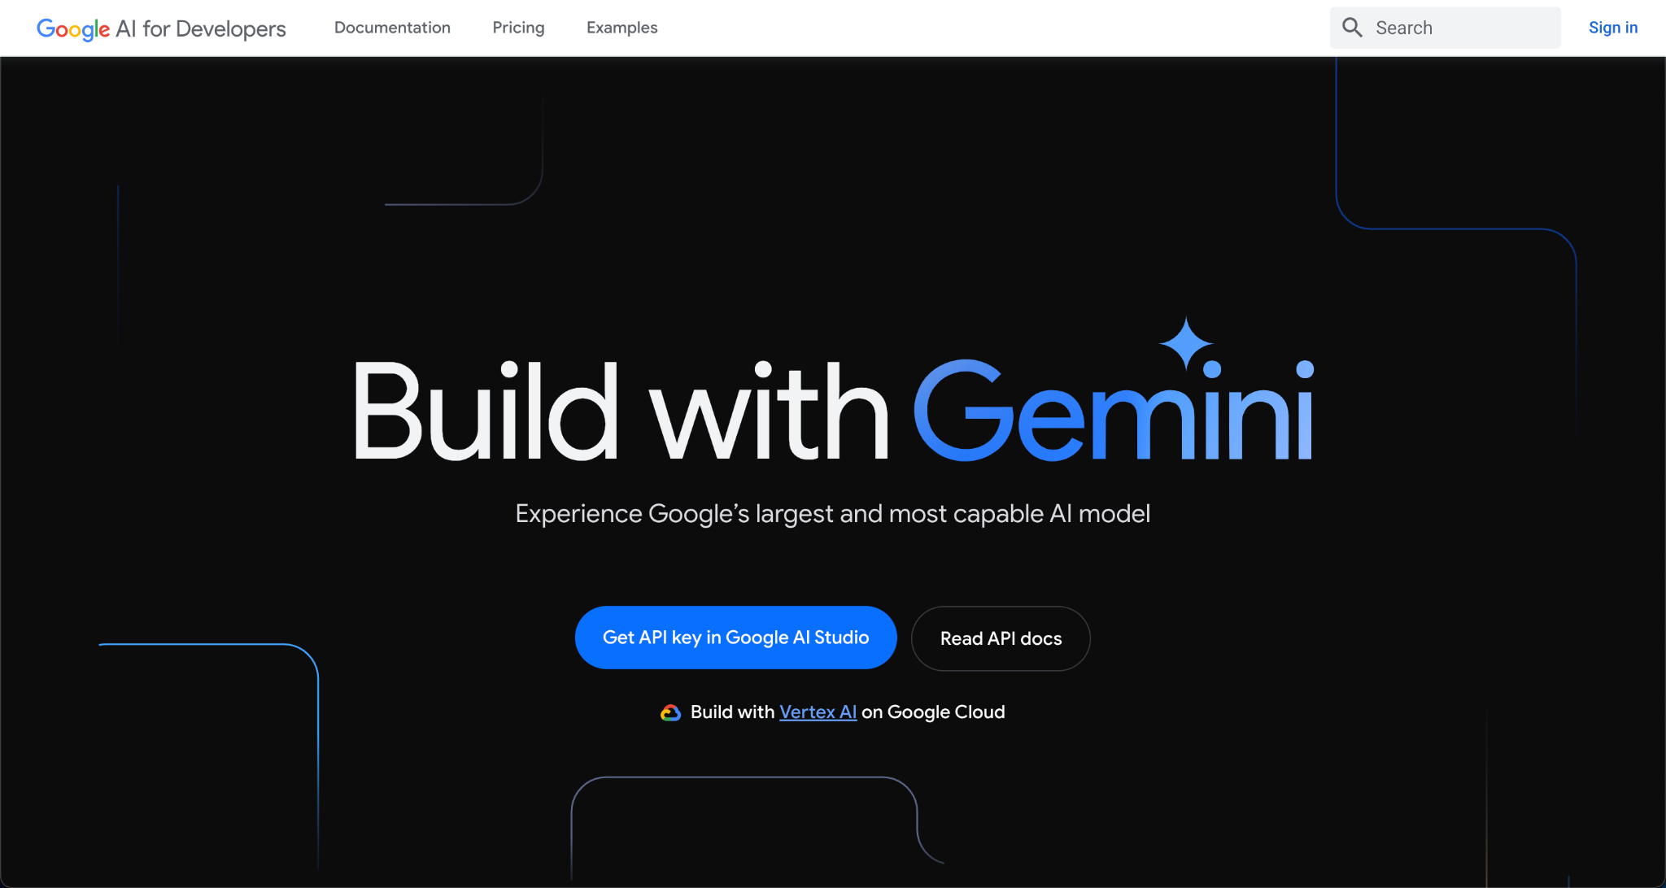
Google Gemini API
https://ai.google.dev/

Slide 35
Demo for Gemini API key

Slide 36
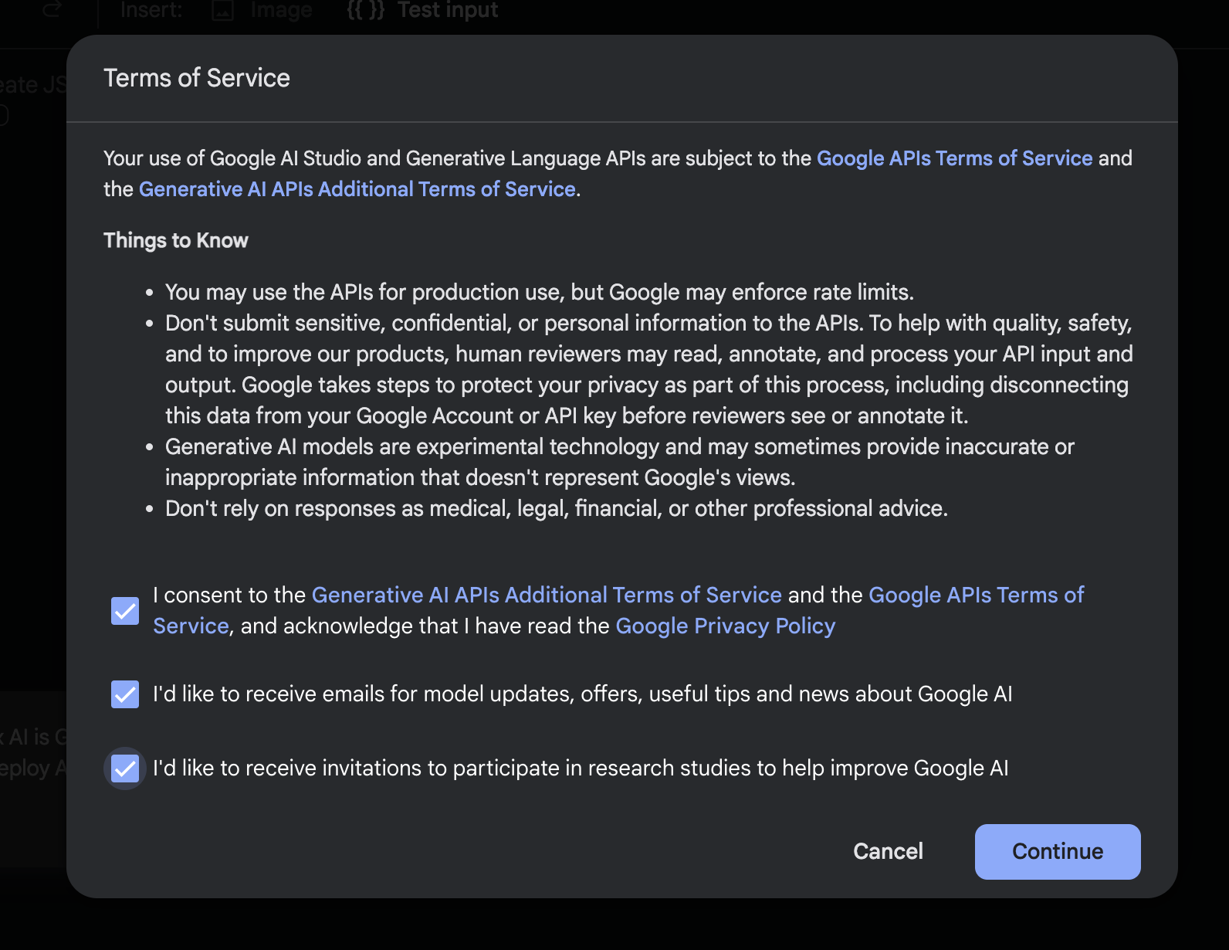
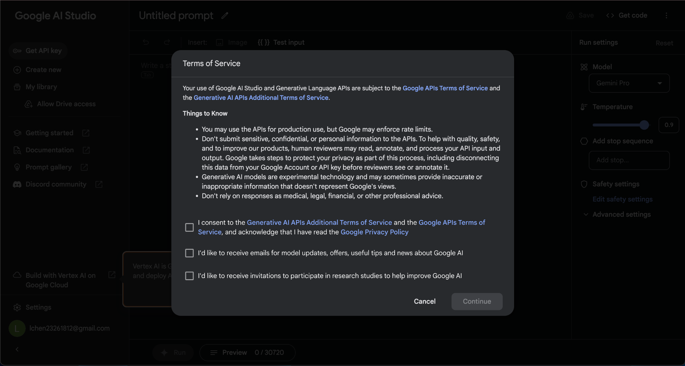
Step 1: Accept Terms of Service

Slide 37
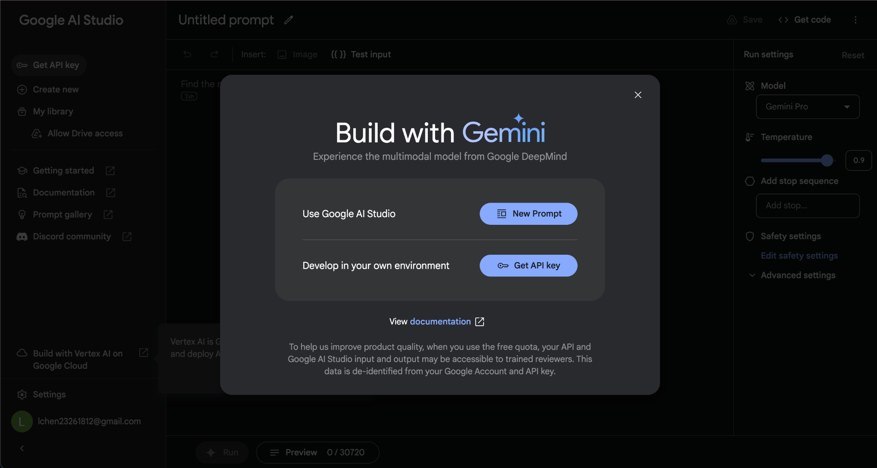

Slide 38
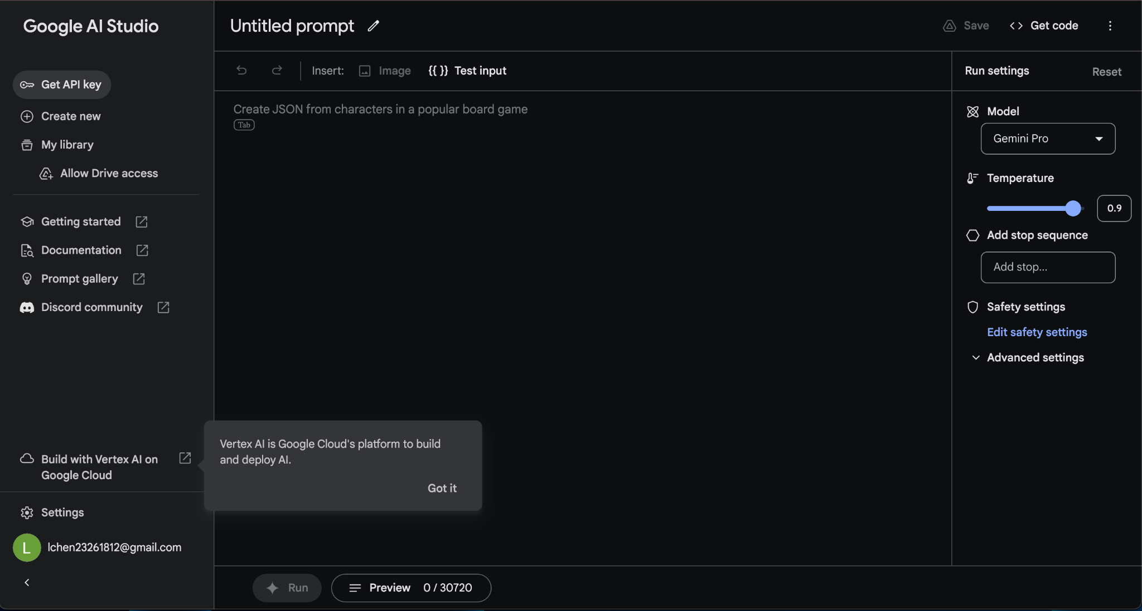
Step 2: Get API Key

Slide 39
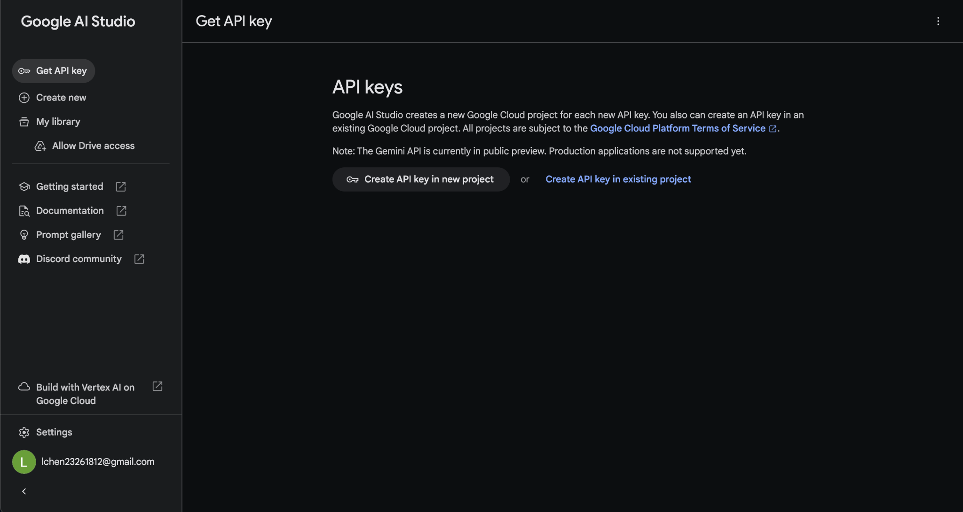
Step 3: Create API Key

Slide 40
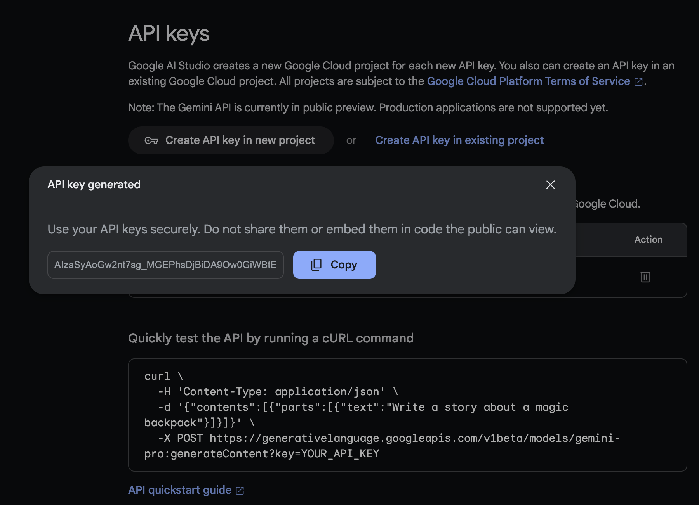
Final: Copy

Slide 41
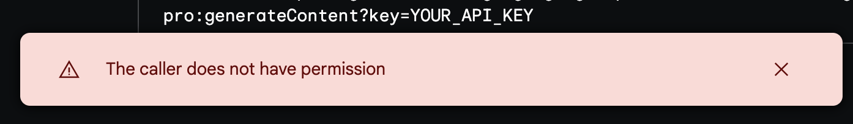
Problems you may encounter
IF
THEN

Slide 42
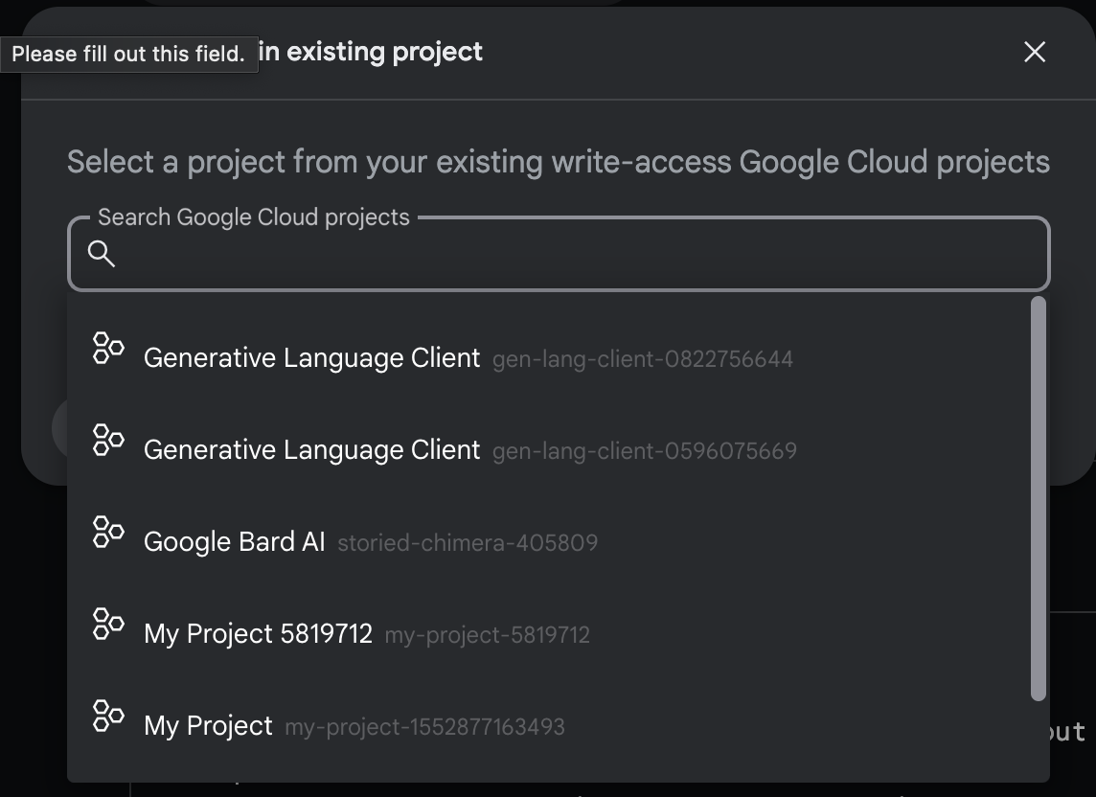
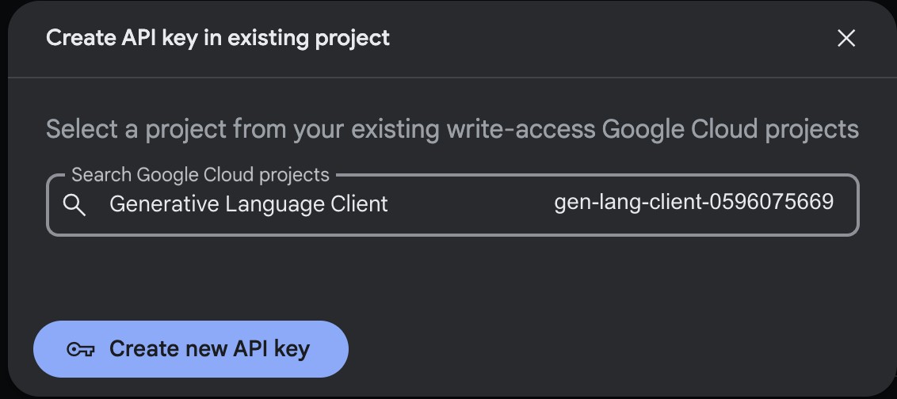
Problems you may encounter
THEN

Slide 43
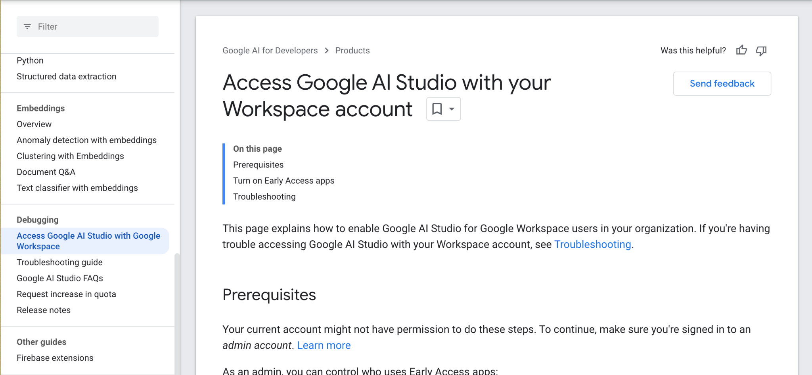
Issue #2
Do not use G-Suite accounts, use your own account

Slide 44
Available APIs: ChatGPT API

Slide 45
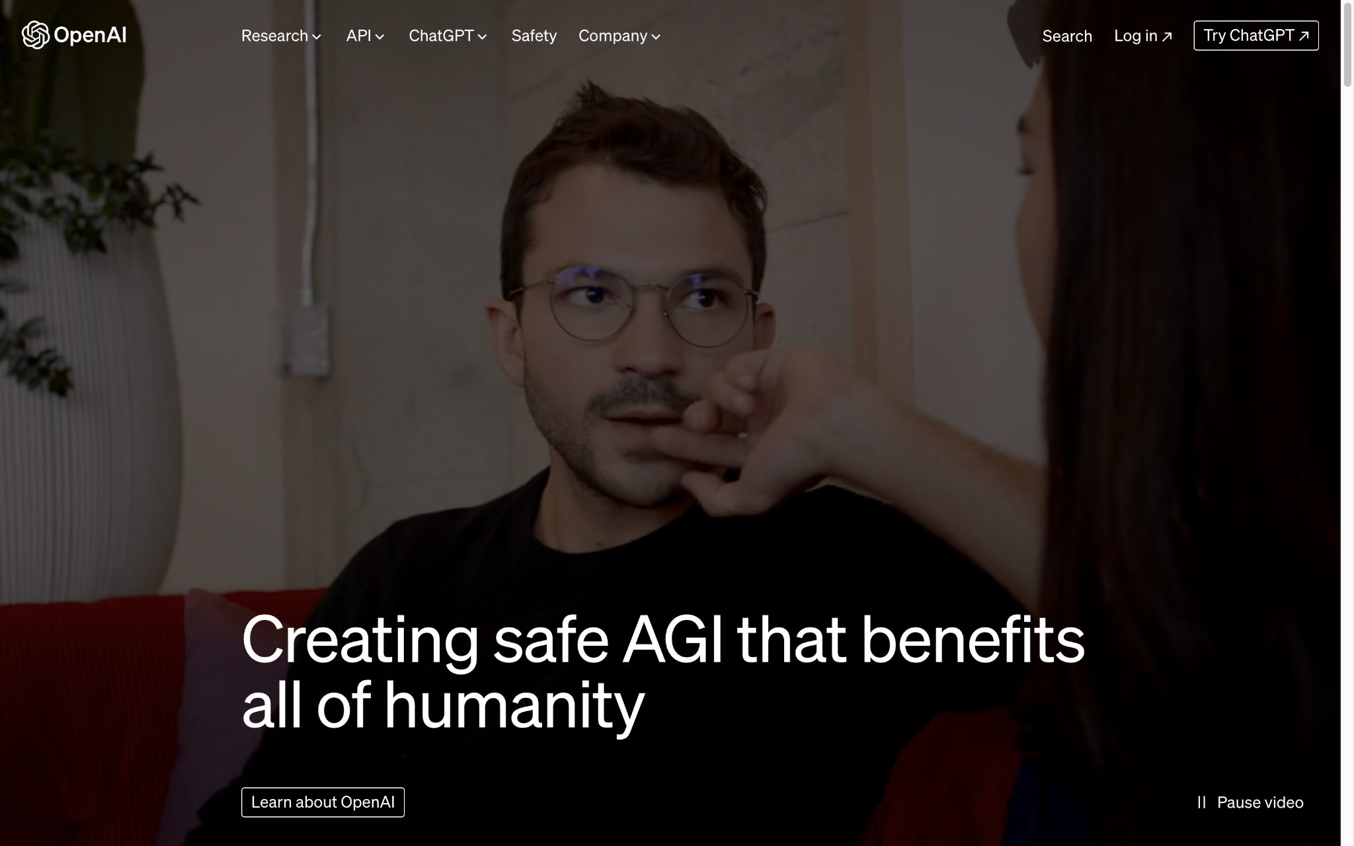
Step 0 - Go to OpenAI Website
https://openai.com/

Slide 46
Demo for ChatGPT API key

Slide 47
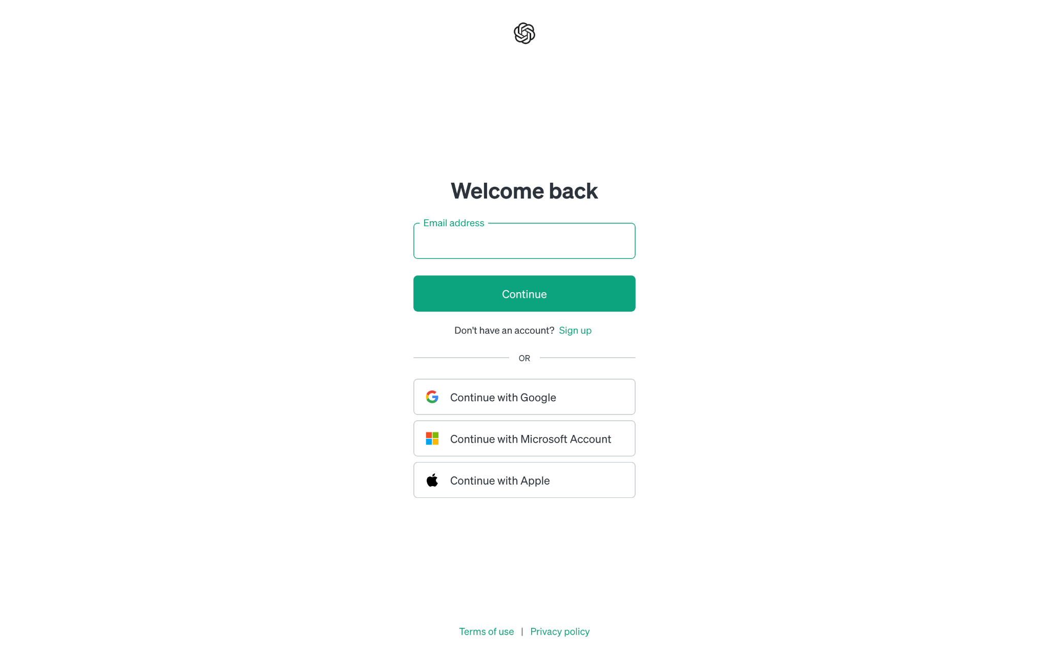
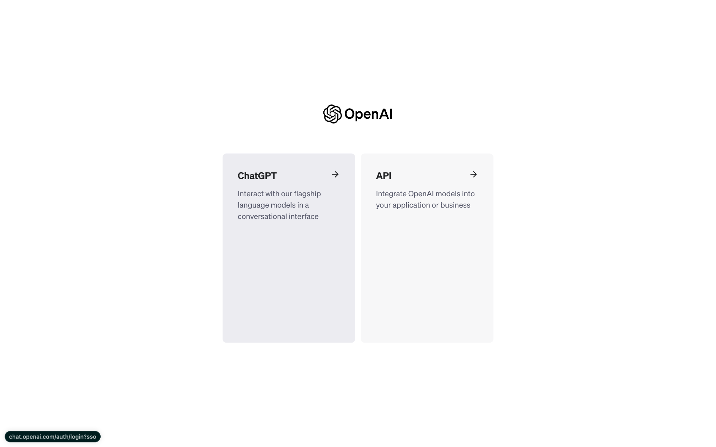
Step 1 - Login/Create Account

Slide 48
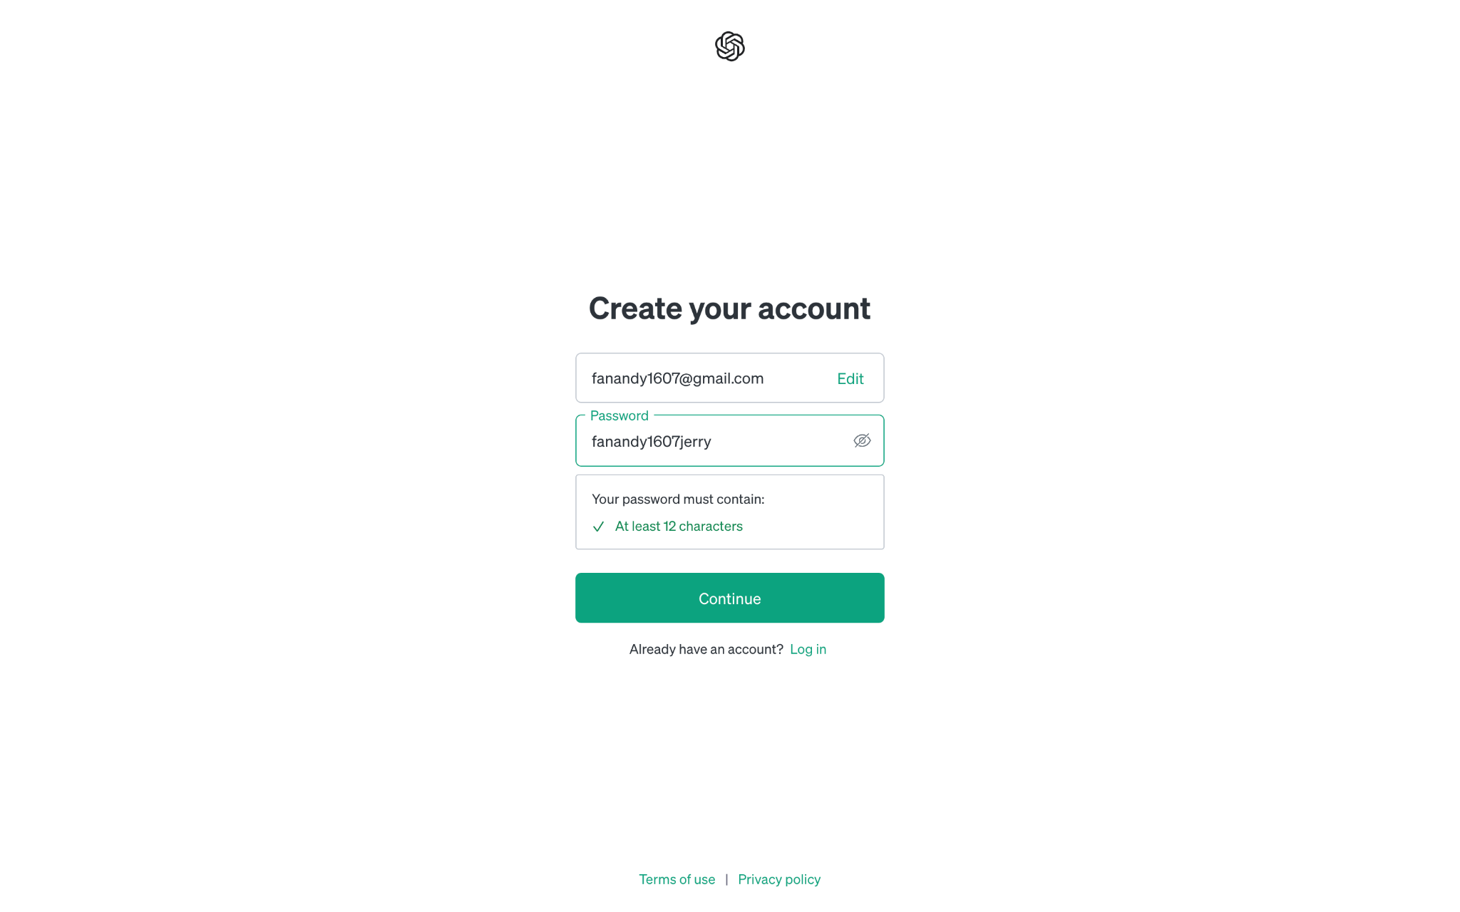
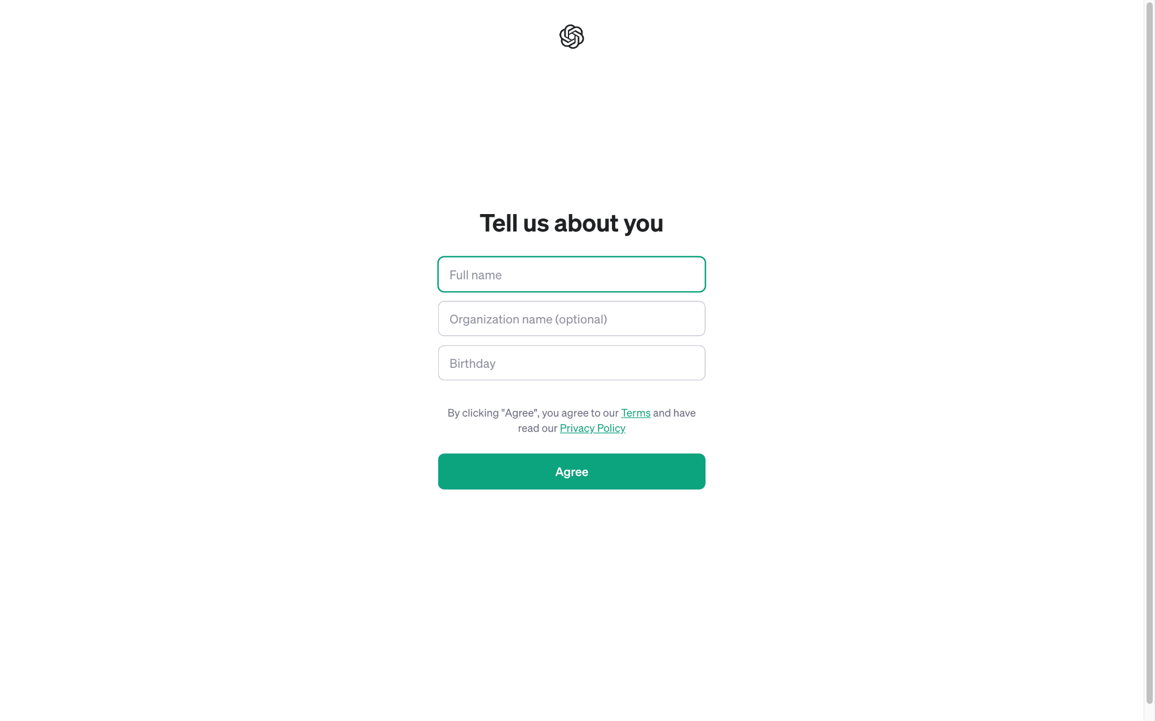
Step 2 - Create Account(Cont.)

Slide 49
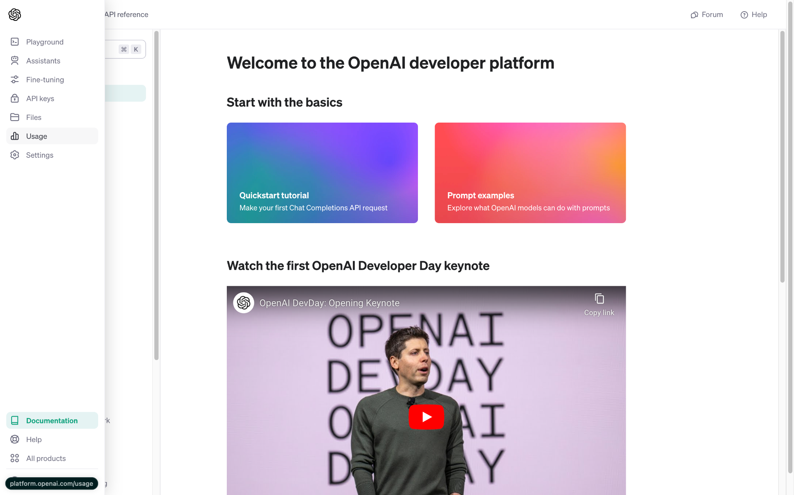
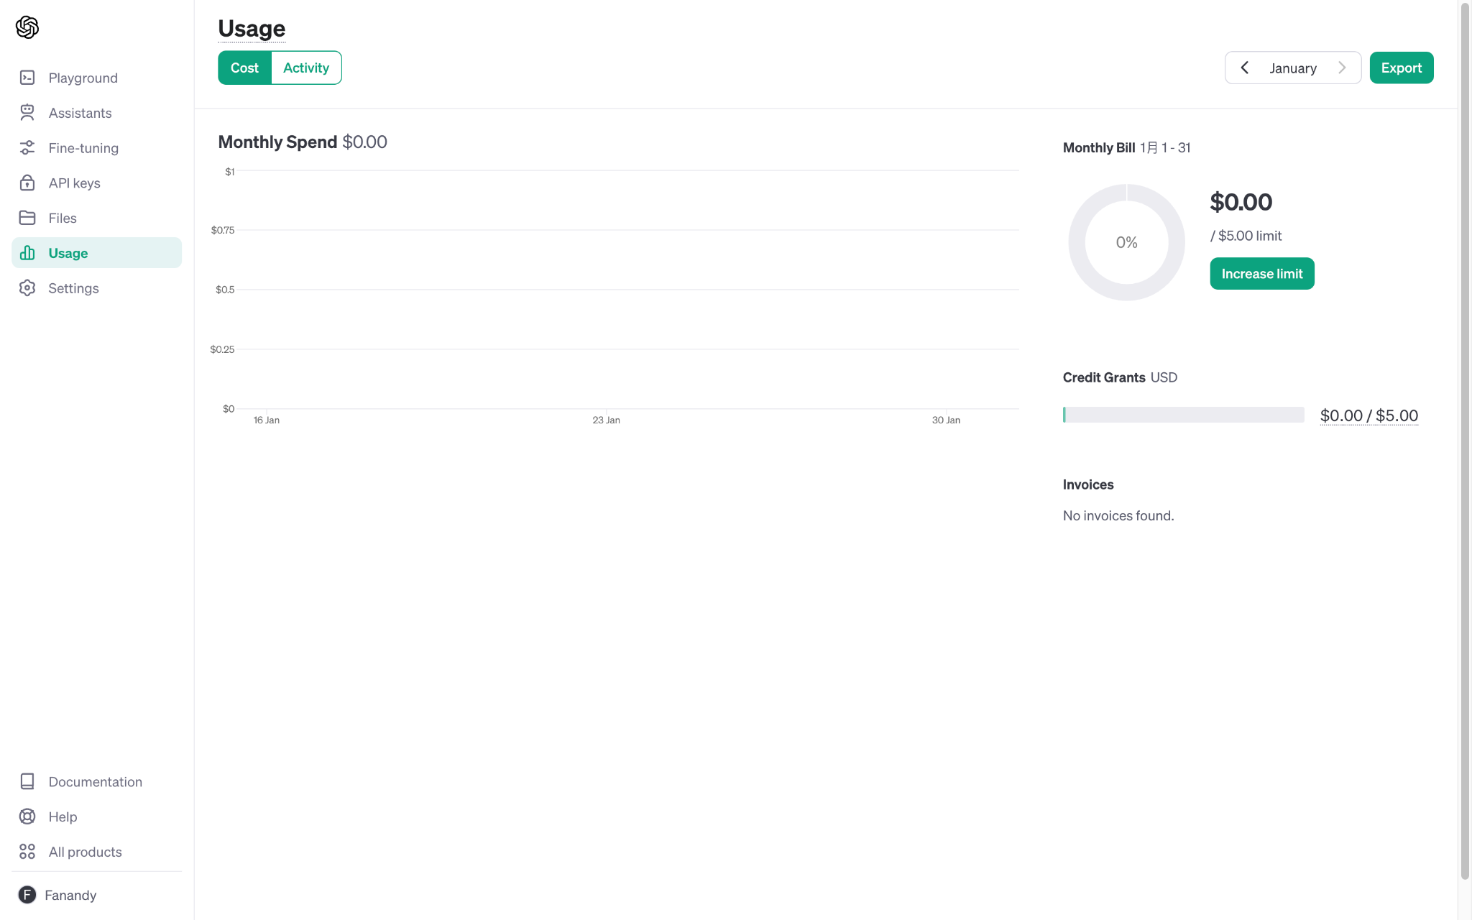
Step 3 - Check Usage

Slide 50
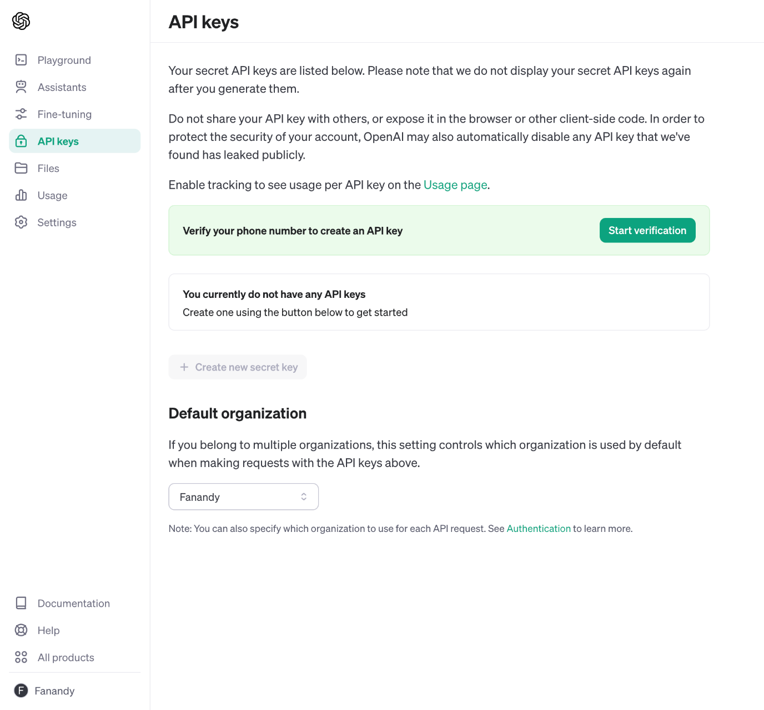
Step 4-1 - Phone Verification
OpenAI API could probably require phone verification
Follow the verification instructions

Slide 51
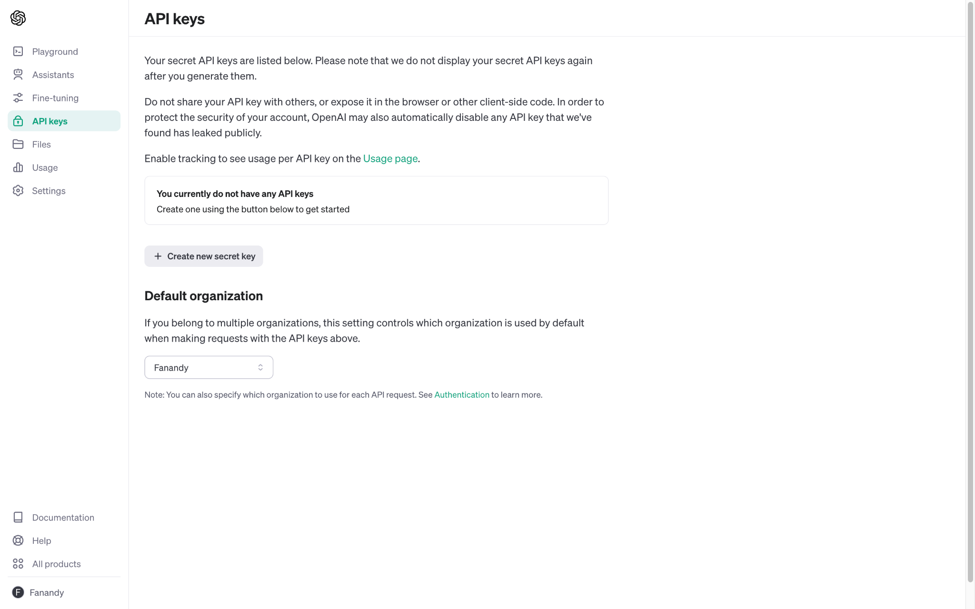
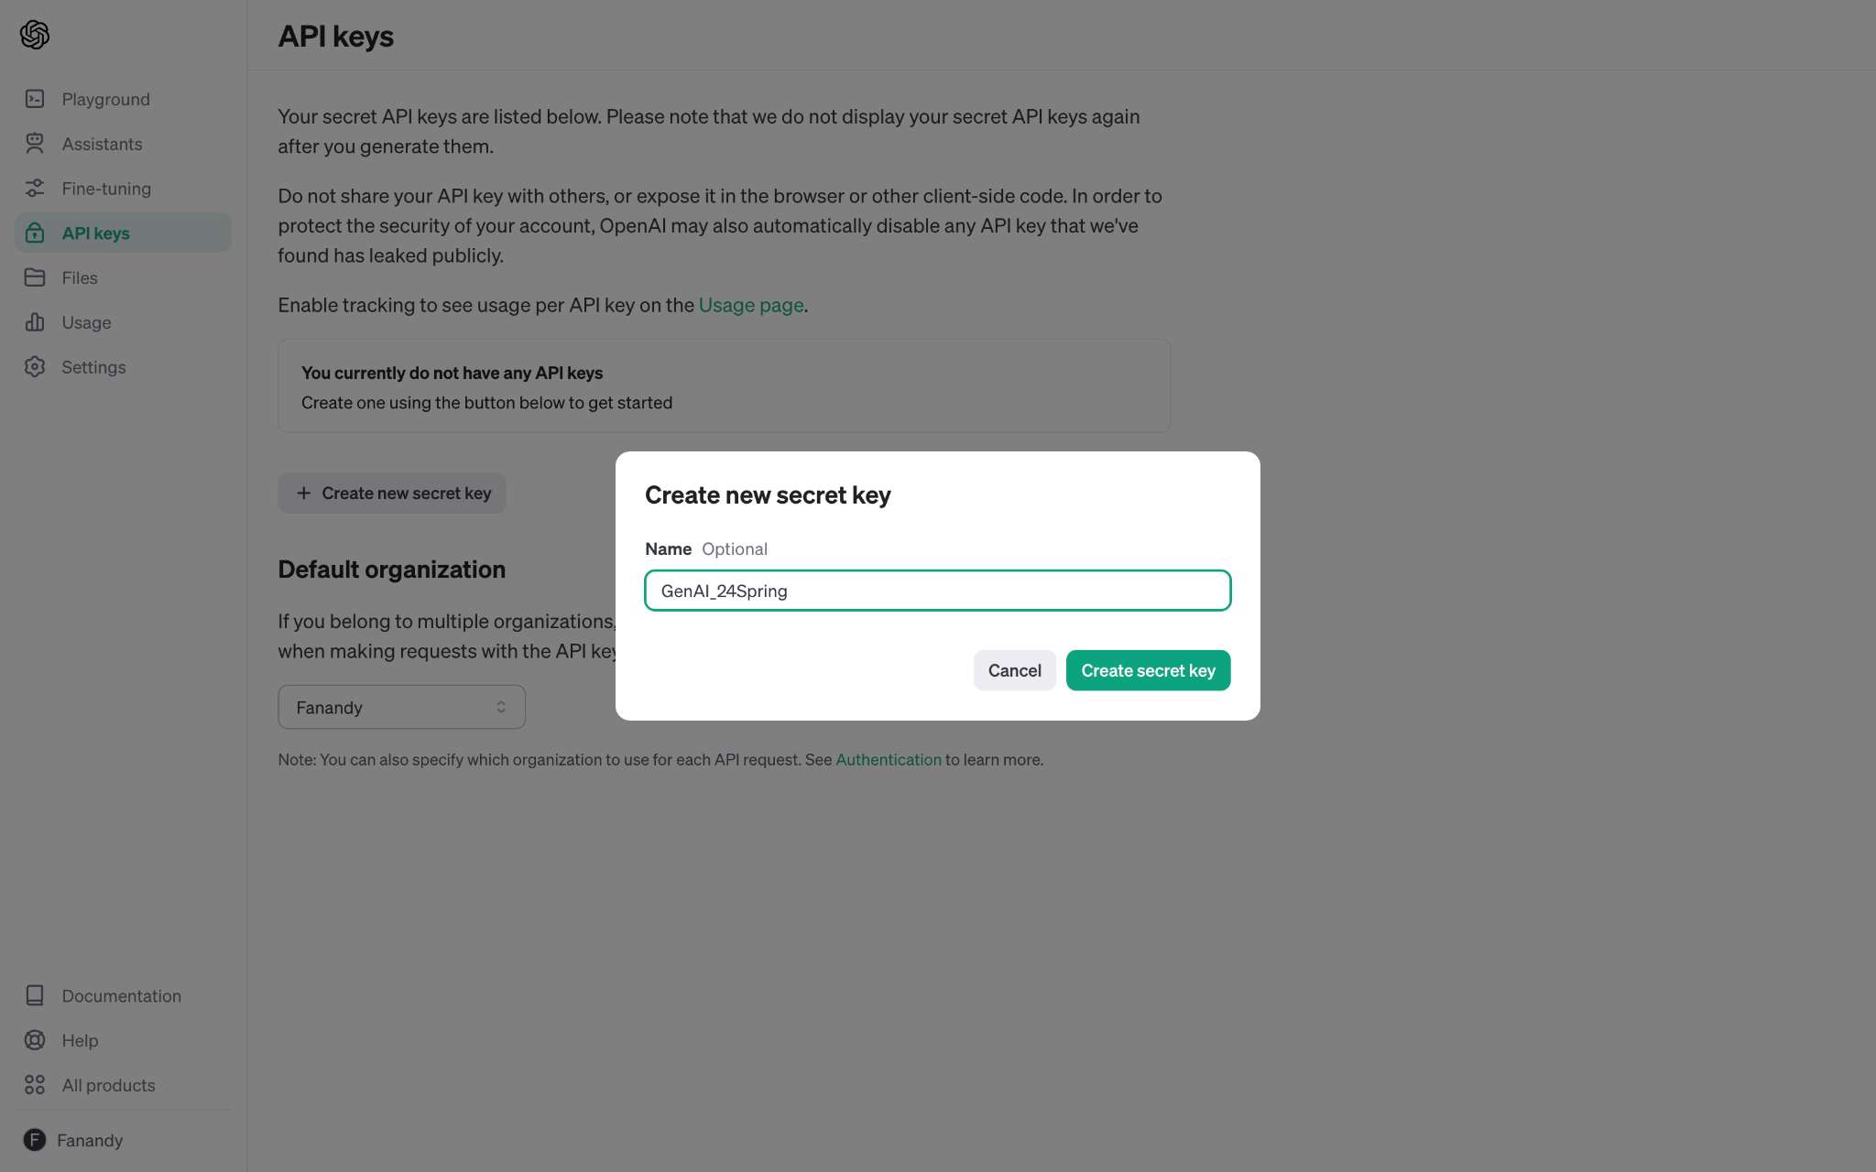
Step 4-2 Create API key

Slide 52
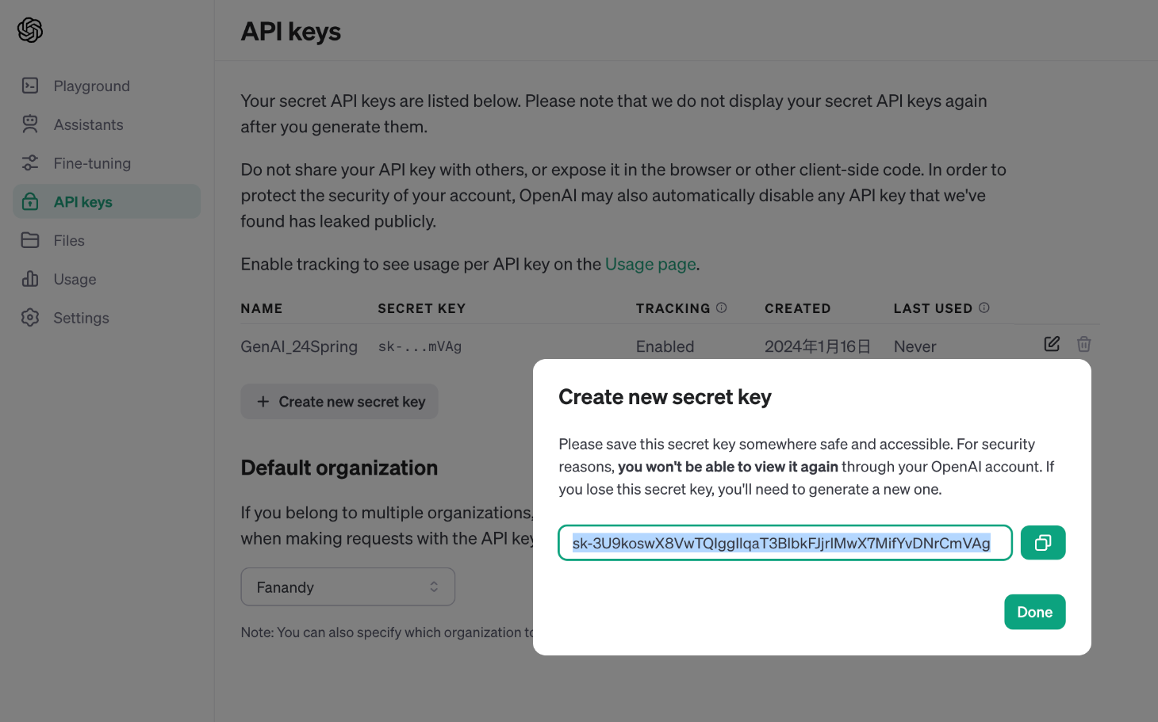
Step 4-3 Copy and take good care of your API key !!!
Please remember to COPY your API key, REMEMBER it and KEEP IT SAFE!
This is the only chance you will see the whole key

Slide 53
OpenAI API - Free Usage
Free usage - If you are a new account to OpenAI : Free $5.00 API usage.
Otherwise, OpenAI API costs money!!!

Slide 54
Task Introduction

Slide 55





Workflow
3. Submit to NTU COOL
1. Call API
2. Evaluate Task
Use Davinci Platform to grade your task
Model: GPT-4
Summarization
Role Playing
Customized Task
Notes:
Call API (Gemini or OpenAI) to get response on Three Task
Summarization (3 points)
Role Playing (3 points)
Customized Task (4 points)
Evaluate your Essay
Submit to NTU Cool

Slide 56
Task
Objective:
Understand how to build your own Language Model Application by calling API and feeding prompts.
Task:
Summarization (3 points)
Role Playing (3 points)
Customized Task (4 points)
Colab link to this homework:
https://colab.research.google.com/drive/15jh4v_TBPsTyIBhi0Fz46gEkjvhzGaBR?usp=sharing

Slide 57
Task Introduction: Task 1: Summarization

Slide 58
Task 1: Summarization
We want you to create a bot that can perform article summarization.
Design a prompt that enables the language model to summarize the article.
Help me summarize ……
[Given article]
USER
Language
Model
Summarized article

Slide 59
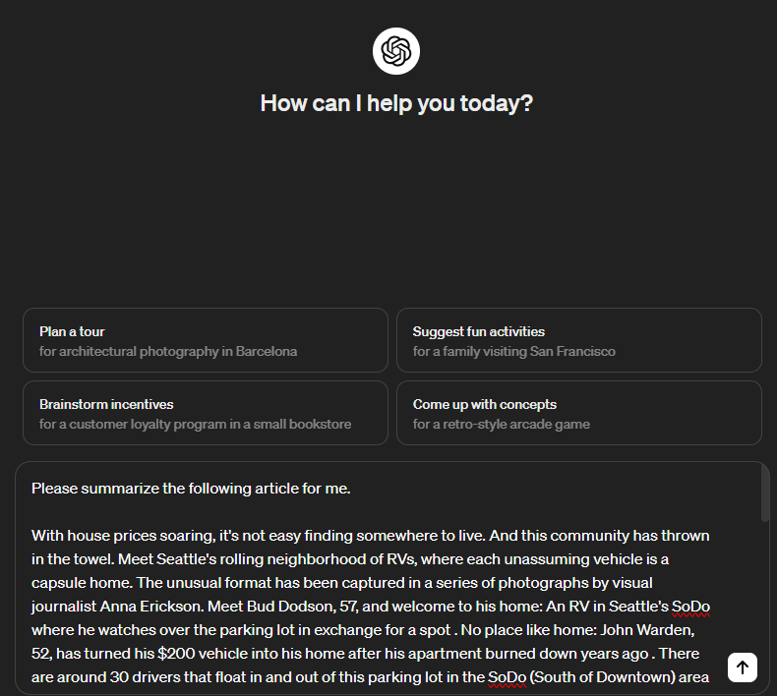
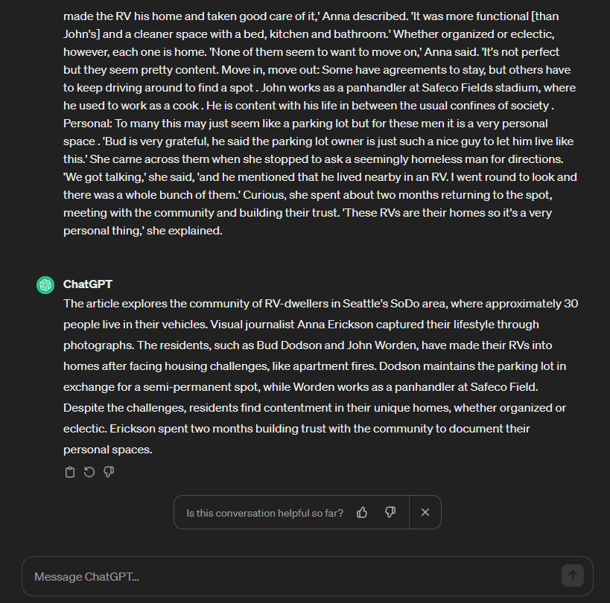
Summarization
Prompt
Article
Send

Slide 60
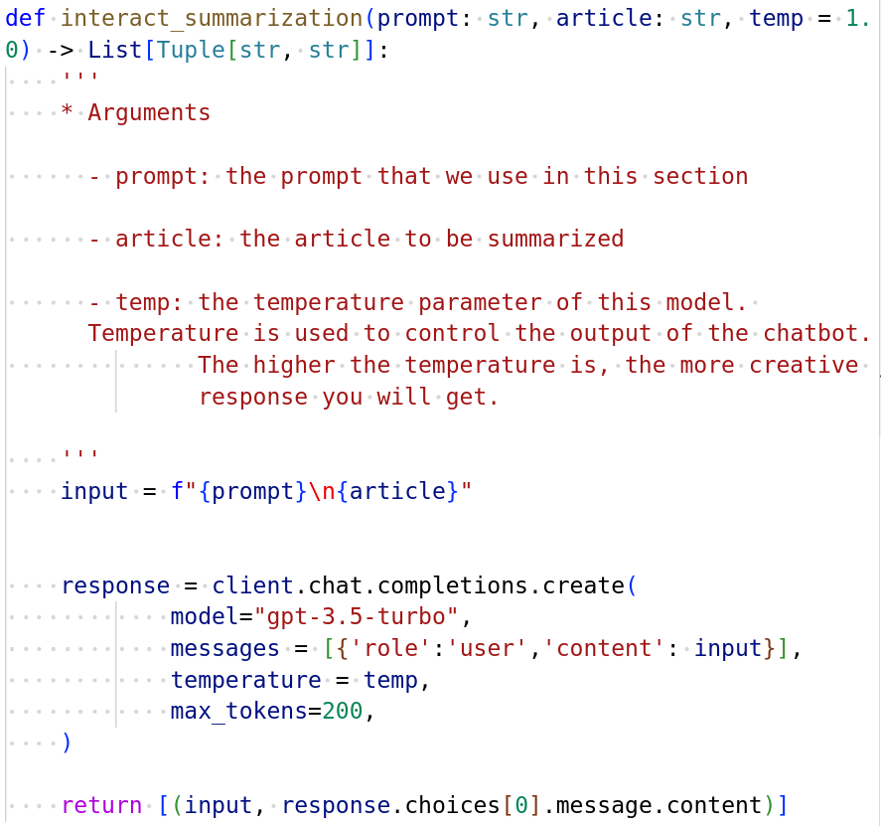
Browser
API Call
Prompt
Article
Prompt
Send
Article
Send

Slide 61

Summarization
Summarization

Slide 62

Step 0
Choose one of the API you want to use
We will use ChatGPT API in the following slides and later demonstrations.
Click one of these two buttons to unfold the codes

Slide 63


Step 1
Run this cell to install the packages
2. Enter your ChatGPT API key here and run this cell
Fill in your ChatGPT API here
Remember to run these two cells whenever you reconnect to colab.

Slide 64


Step 2
Under this text cell Part1: Summarization
Fill in your prompt for summarization in "FILL IN YOUR PROMPT" and hit the run button.
Example: “Please summarize this article for me.”

Slide 65
Step 2
The prompt you just filled in will be used in the API call to instruct ChatGPT what it should do

Slide 66

Step 3
There will be a gradio interface like this pop up.
Here you can enter whatever article you want to summarize

Slide 67
Step 3
The article will also be a part of the input to ChatGPT

Slide 68

Step 4
You can use this slider to adjust the temperature here.
The higher the temperature, the more creative response you will get.
Hit “Send” to get the response.

Slide 69

Step 5
The response will display in gradio like this

Slide 70

Save your results
For each tasks, after you get a satisfied result. Make sure to hit the “Export” button.
If you hit the “Export” button again, the old file will be replaced.

Slide 71


Save your results
After that, you will see the file appeared in the file list.
Make sure to download it to your own computer before it disappear.

Slide 72

After you save your results …
Go to “Check and print your result” for the corresponding part
RUN IT

Slide 73


Copy
Paste

Slide 74
Demo for Task 1

Slide 75
Task Introduction: Task 2: Role Playing

Slide 76
Task 2: Role Playing
We want you to design a bot service that you can play a role play game with the LM.
Engage in a multi-turn conversation with the LM
Prompt: Tell the chatbot to play whatever character.
Later inputs: Interact with the chatbot.
I want you to act as a pirate. Explain your job to me.
USER
Language
Model
I'm a digital pirate, sailing the info-seas! 🏴‍☠️

Slide 77
Rules: Role Play
Communicate with the LM for 2 rounds (excluding the prompt)
User → LM, LM Response (這樣算一次)
Input: You are Shakespeare. Write me a really short poem.
USER
Language
Model
"In moon's soft glow and star's tender light, Love whispers true in the hush of night."
Note: Observe the multi-turn conversation (history of conversation recorded)

Slide 78


Output
Prompt
Send

Slide 79


History
New Output
New Input

Slide 80

Input
Input
Send
Send

Slide 81

History
user: The input you typed
assistant: The output the bot generated
New Input
History
New Input
When using API, you have to record the history manually.

Slide 82
New Output
New Output
When using API, you have to record the history manually.

Slide 83
Whole Dialogue
Whole Dialogue
When using API, you have to record the history manually.

Slide 84


Note
Role: Fill in the role you want and it will be in the red block below
Input: Actual Input for conversation.

Slide 85
Demo for Task 2

Slide 86
Task Introduction: Task 3: Customize Task

Slide 87

Task 3: Customize Task
We want you to create a customized service bot.
You can think of any tasks that you want the Bot to do. For example,
A bot that can solve simple math problems
A bot that always output the antonym of the user’s input word
Any creative tasks that you can think of
Be Creative!

Slide 88
Task 3: Customize Task
Enter a prompt for LLM to perform a certain “Task” (Do not use tasks that will produce too long outputs, specifically 1k tokens).
Enter the input of “Task”
Single or multiple rounds are both ok, but do not exceed 3 rounds.
Export the conversation log
Prompt: “Give me the antonym of the following words”
Input: “Big”
USER
Language
Model
Result: “Small”

Slide 89


Output
Prompt
Input
Send

Slide 90

Prompt
Input
Prompt
Input
Send
Send

Slide 91
Output
Output
Both single-turn and multi-turn is acceptable.

Slide 92


Note
Fill in the description of your task and it will be in the red block below
(e.g. Give antonym )
Actual Input for conversation.

Slide 93
Demo for Task 3

Slide 94
How to Delete Your API Keys

Slide 95

OpenAI API
https://platform.openai.com/api-keys
Click here to remove the delete API keys

Slide 96

Gemini API
https://aistudio.google.com/app/apikey
Click here to remove the delete API keys

Slide 97
Issues You Might Encounter

Slide 98


ModuleNotFoundError : No module named ‘xxx’
If you encounter this error
You haven’t installed the packages yet
Solution: Execute corresponding code block (e.g. !pip3 install xxx)

Slide 99


NameError : name ‘List’ is not defined
If you encounter this error
You haven’t import the packages
Solution: Execute this code block

Slide 100

FileNotFoundError : [Errno 2] No such file or directory
If you encounter this error
You might forgot to export the json file or upload one.
If not, refer to
corresponding pages such as
p67
Solution:
Please check if there exists the required json file
1.

Slide 101


Gradio UI not showing : block running but not working
If you encounter this error
You might forgot to stop other code blocks (especially those Gradio UI blocks)
Solution:
Check and stop other running code blocks

Slide 102

Wrong API key
If you see this output (The block will finish execution without error occurring)
Solution:
Refer to p33-p42 (Gemini)
p43-p52 (OpenAI)
to double check if you retrieve the correct API key.
Then fill in the api key as the description (refer to p62)

Slide 103

Prompting Issue
Problem: Several prompts will encounter such error.
Solution: Change your prompts

Slide 104
Evaluation Assistants on DaVinci for Grading

Slide 105
Grading
Model Version: GPT-4-Turbo-8k
Assistant: GenAI Homework3 Assistant
3 Prompts
Summarization Grader
Roleplay Grader
Customized Task Grader
Copy your result to the Grading Assistant in DaVinci Platform.
Link of Davinci Platform: https://dvcbot.net/

Slide 106
DaVinci Install Assistant

Slide 107

1. Press “+ Chat”
2. Choose “Assistant”

Slide 108

1. Search “GenAI Homework3 Assistant”
2. Click “GenAI Homework3 Assistant”

Slide 109

1. Install

Slide 110
DaVinci Grading

Slide 111


1. Create a new chat for each task
2. Click to see Assistant list
⚠️ Ensure to open a NEW chat every time you re-evaluate the result
3. Choose
(GenAI Homework3 Assistant)
4. Choose your Grader/Task

Slide 112

Fill in these textbox with results from Colab

Slide 113

Assistant gives feedback and a final score for your essay
Press this to download as .json file

Slide 114
Demo for Evaluation Assistants on DaVinci for Grading

Slide 115

Daily Usage Limit
There is a daily usage quota limitation on the DaVinci platform, based on your quota, you can run
Summarization: ~5 times/day, or (not and)
Role Play: ~10 times/day, or (not and)
Customized: ~15 times/day
Note: This depends on the amount of words you input
You can also check the bottom left of Davinci Platform remaining usages

Slide 116
BE CAREFUL
Avoid Harmful Prompts and Tasks
Harmful, offensive, or disrespectful prompts or task will most likely receive a low score.

Slide 117
Evaluation Prompts for 旁聽生
For those who wants to judge their score by themselves, we provide the full prompts for evaluation list here:
Summarization
Roleplay
Customized
To use the prompt, replace the contents inside {{ }}.
Eg. Replace “{{article}}” by your article in summarization task.

Slide 118
Submission

Slide 119
Submission (NTU COOL)
NTU COOL
Turn in the json file you exported from the DaVinci Platform
Rename it as the following format, lower case
<student_ID>_part1_hw3.json
<student_ID>_part2_hw3.json
<student_ID>_part3_hw3.json

Slide 120

Submission (NTU COOL)
Do not submit code
Json File must include score for each task given by grading assistant, like this:
No restrictions on upload quota but only the most recent submission will be kept
No late submission is allowed
Please make sure that you submit .json files otherwise you will get 0 points.
BE CAREFUL NOT TO SUBMIT THE JSON FILE PRODUCE FROM COLAB OTHERWISE YOU WILL GET 0 POINT
⚠️ We will compare the files you submit with our backend data records to ensure they match. Therefore, please do NOT manually edit your JSON file.

Slide 121
Important Dates

Slide 122
Important Dates
Deadline for Submission (NTU Cool)
2024/03/21 23:59:59 (UTC+8)
Grading Release Date
2024/04/04 23:59:59 (UTC+8)

Slide 123
Regulations

Slide 124
Regulations
Plagiarism in any form is prohibited.
Do NOT share your prompts and evaluation results (JSON files) with others.
Do NOT submit the JSON files that are not obtained using your Davinci account
Do NOT attempt to manually edit your JSON files.
第一次違反以上規定，該作業0分，學期總成績再乘以0.9
第二次違反以上規定，學期成績F
Prof. Lee & the TAs preserve the rights to change the rules & grades.

Slide 125
If You Have Any Questions
NTU Cool HW3 作業討論區
如果同學的問題不涉及作業答案或隱私，請一律使用NTU Cool 討論區。在發問前請使用 NTU Cool 討論區的搜尋功能找找看你的問題是不是有人問過了
助教們會優先回答NTU Cool討論區上的問題
如果寄信問的問題已經在NTU Cool 討論區回答過了，助教只會回信跟你說這題已經在NTU Cool 回答了，助教不會在信件中回答你
如果是要問程式出錯的問題的話，請將錯誤訊息連同在哪裡發生的一起截圖傳給我們
Email: ntu-gen-ai-2024-spring-ta@googlegroups.com
Title should start with [GenAI 2024 Spring HW3]
Email with the wrong title will be moved to trash automatically
TA Hours
Time: 3/8 (16:30 - 17:20)、3/15 (13:30-14:20, 16:30 - 17:20)
Location: 綜合大講堂

